Slide 1
Digital Portfolio
STUDENT NAME: NAVEENKUMAR J
REGISTER NO AND NMID: 222401223 And asunm11024ai113
DEPARTMENT: BSc.Computer Science with AI COLLEGE: MADRAS UNIVERSITY

Slide 2
PROJECT TITLE
STUDENT PORTFOLIO USING FRONTEND
DEVELOPMENT

Slide 3


AGENDA
Problem Statement
Project Overview
End Users
Tools and Technologies
Portfolio design and Layout
Features and Functionality
Results and Screenshots
Conclusion
Github Link
3/21/2024 Annual Review

Slide 4

PROBLEM STATEMENT
Students often struggle to present their academic achievements, technical skills, and projects in a structured and professional format.
Traditional resumes are static and lack interactivity, making it difficult for recruiters or peers to quickly access and evaluate information.
There is a need for a dynamic portfolio website that acts as a digital resume and makes it easier to showcase skills, projects, and personal branding.

Slide 5

PROJECT OVERVIEW
This project is a Student Portfolio Website that contains multiple sections:
Profile Photo & Intro
About Me
Education
Skills
Projects
Contact Information
The website is responsive, easy to navigate, and highlights the student’s technical abilities and achievements.

Slide 6

WHO ARE THE END USERS?
Students – to showcase their profile, skills, and projects.
Recruiters/Employers – to quickly review the candidate’s skills and achievements.
Teachers/Mentors – to evaluate the student’s work presentation.
Peers/Collaborators – to explore project ideas and connect for collaboration.

Slide 7

TOOLS AND TECHNIQUES
HTML5 → for website structure
CSS3 → for styling, layout, and responsive design
JavaScript (Vanilla JS) → for interactivity (active navigation highlighting, smooth scrolling)
Responsive Design Techniques → media queries for mobile-friendliness
Code Editor → VS Code / Sublime / Notepad++ Browser → Chrome/Edge/Firefox for testing

Slide 8
POTFOLIO DESIGN AND LAYOUT
Header Section → Profile photo, name, tagline, and navigation menu.
About Section → Introduction and personal background.
Education Section → Academic details.
Skills Section → Technical & soft skills displayed with styled badges.
Projects Section → Highlights of important academic and personal projects.
Contact Section → Email, LinkedIn, GitHub links.
Footer → Copyright and credits.
The layout follows a clean, minimal, and modern design with a
centered profile and card-based content sections.

Slide 9
FEATURES AND FUNCTIONALITY
Responsive design (works on mobile, tablet, and desktop).
Profile photo integration for personalization.
Navigation bar with active link highlighting while scrolling. Smooth scrolling effect for better UX.
Card-style sections for readability.
Clickable contact links (email, LinkedIn, GitHub). Simple and lightweight (no frameworks needed)

Slide 10
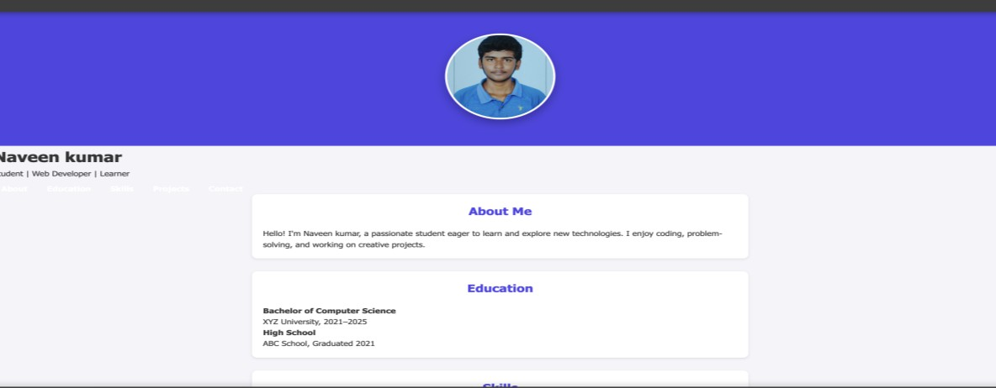

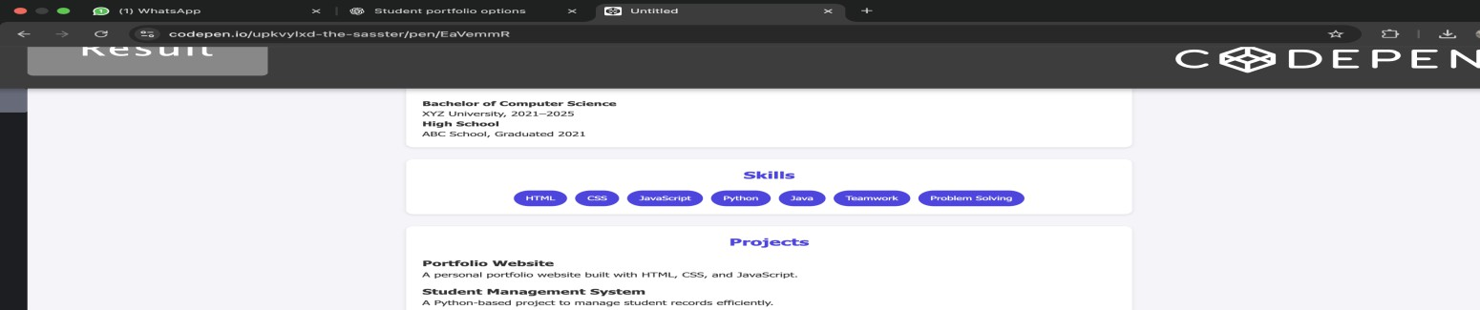
RESULTS AND SCREENSHOTS
3/21/2024 Annual Review
10

Slide 11
CONCLUSION
The Student Portfolio Website successfully provides a modern digital resume for students.
It is:
✅ Easy to use
✅ Visually appealing
✅ Responsive and interactive
✅ Helpful for career opportunities and academic presentations
11

